Slide 1
Introduction to TB NPOC Early Adopter Initiative
Enos Masini
The Global Fund
29th Sept 2025

Slide 2
Agenda
Pipeline and imminent products for NPOC diagnostics
Implementation considerations for NPOC diagnostics
Global Fund supported Early Adopter Initiative

Slide 3
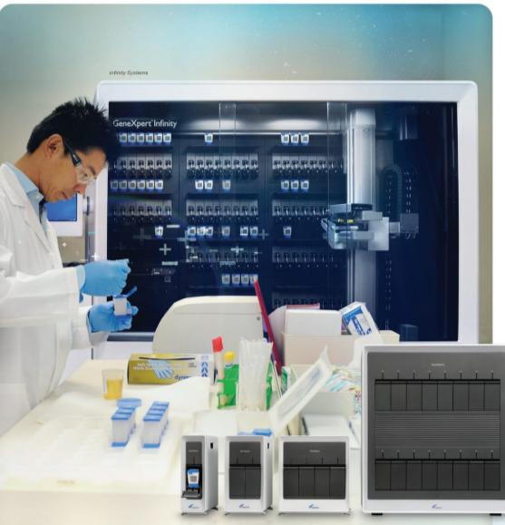

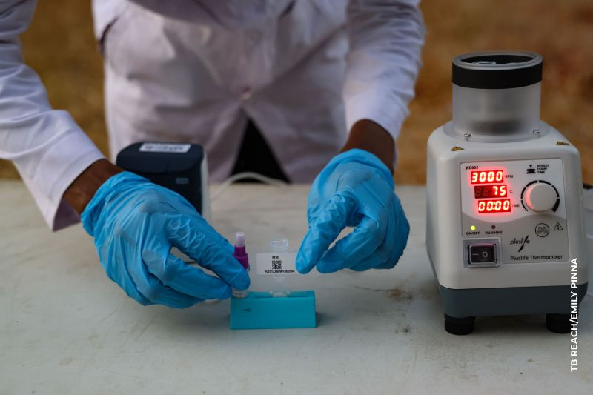

Catalyzing Change: How to offer those 52% not getting WRDs a molecular diagnosis?
Challenge:
Over 2.5 million people undiagnosed with TB annually.
Only 48% of people with TB are diagnosed with a rapid molecular test.
Primary barriers:
High costs;
centralized testing infrastructure; limited access at PHC levels;
limited sample transportation
Solution* (NPOC):
Potential to increase access to TB molecular diagnostics, even at peripheral level
Will decrease initial loss-to-follow-up by allowing same-day diagnosis
Could allow for same-day treatment initiation
Decentralized, near point-of-care testing
Specialized lab infrastructure
Smear microscopy
UNHLM target of 100% of people diagnosed with a rapid molecular test by 2027.

Slide 4
WHO Target Product Profile for TB NPOC diagnostics
Characteristic​ | Minimal Requirements​
Form​ | Instrument should be battery-operated and not require any special infrastructure
Intended purpose​ ​ | Detect pulmonary TB, at the peripheral level, to support TB therapy initiation during the clinical encounter or on the same day
Target use​ | Health workers with basic technical skills (e.g. non-precision pipetting and minimal sample processing)​
Healthcare setting | Peripheral microscopy centers and PHCs
Cost ​ | Instrument: ≤US$ 2,000​ Test: ≤US$ 6 (Optimal = ≤US$ 4)​
Performance​ (sensitivity) | 85% (Sputum)​ 75% (Non-sputum)​
Time to result​ | <60 mins (Optimal ±15 mins)​
Likely to reach <US$ 4 per assay and <US$ 1,000 per instrument(s) within GC8.

Slide 5
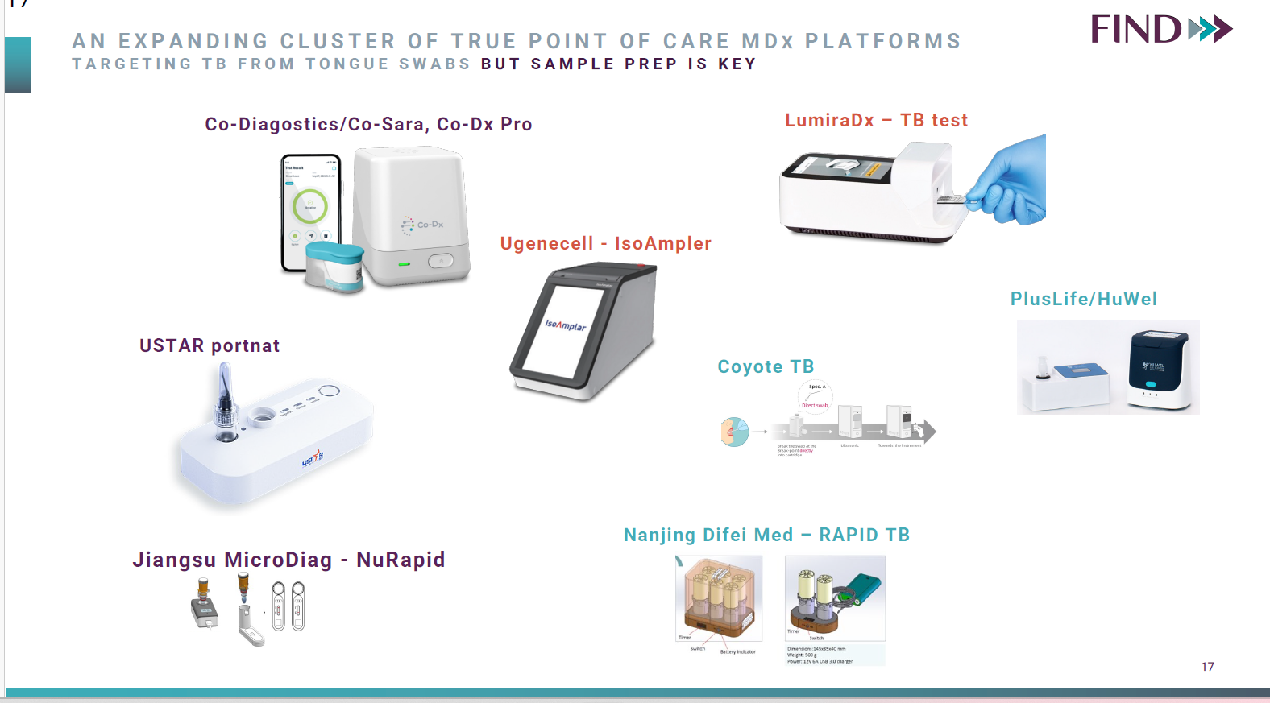
The Pipeline
At least three manufacturers could enter the market in the next 18 months.

Slide 6
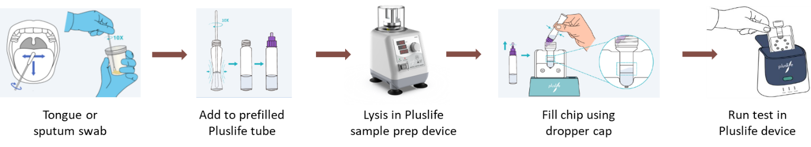
First in-class, Pluslife MiniDock MTB test with ERP-D approval for Sputum as sample
Pluslife MTB Test | Sensitivity | Specificity
Tongue Swab | 72.9% | 99.4%
Sputum Swab | 81.2% | 97.4%
COMPARATOR TESTS
Sputum Xpert | 85.9% | 98.3%
Sputum Smear | 53.5% | 99.9%
People >12yrs with presumed TB. Data presented at ASLM ECHO Session.
For more info check ECHO Session August 2025 “Non-sputum-based tests to close the diagnostic gap for TB”
Notes:
To highlight here the sensitivity for Sputum and tongue swab meeting TPP criteria AND that both are better than microscopy.
Preprint of this paper is now available - https://www.medrxiv.org/content/10.1101/2025.04.12.25325603v1.full-text

Slide 7




Understanding the MiniDock MTB test
1. Core Capabilities
2. Limitations
Does NOT currently have DST and therefore will not replace current molecular diagnostic tests offering DST.
Has multiplexing capabilities. It has 12 other tests available including for MPox, HPV, SARS-CoV-2, Strep A, Pertussis, Legionella, Flu A/Flu B/RSV, however none are WHO PQed or ERPD approved yet.
Is a rapid molecular test for TB, complimentary to current tests.
Provides a traffic light signal (Green- Yes for TB, Red-No for TB, No color-Invalid result).
Two-step process requiring lysis (separate platform) and the MiniDock test reader.
Can run up to 8 hours on battery.
3. Operational requirements
Requires electricity for recharging: Two separate batteries needed for both lysis machine (12V) and MTB MiniDock platform at an additional cost.
Sample transportation needed if no DST available on site.
Company is working on digital/app to link results to electronic systems – will require additional costs.

Slide 8



NPOC is not just a tool-it’s a new approach
1. Access
2. Quality
3. Cost containement
Decentralization to PHC levels will increase access to communities and allow for potential same-day treatment initiation.
Tongue swabs are beneficial for children and PLHIV who struggle to produce sputum.
Replacement of diagnostic smear microscopy with molecular tests will improve the quality of TB diagnostics.
Reduce cartridge costs by using NPOCs as an initial test. Positive samples requiring drug sensitivity testing, globally estimated at approx. 10% of WRD tests.

Slide 9



Where can NPOCs add the Most Value?
The goal is to solve persistent barriers to TB Diagnosis
Challenges and approach
Cost: Placed in existing Low-Complexity (LC) aNAAT sites. Becomes initial diagnostic test, reflex testing positive samples in LC-aNAAT or high throughput technologies for drug sensitivity testing.
Coverage of WRD: Replacement of diagnostic sputum microscopy, placed at microscopy sites (for diagnosis).
Improved access: Decentralization to PHC levels, increasing access to communities.
National Reference Lab
Regional Lab
Regional Lab
District Lab
District Lab
District Lab
Primary Care
Primary Care
Primary Care
Community setting
Source: Reproduced from Nichols et al

Slide 10
Critical Data needs for TB Program Planning
Beyond Accuracy
Diagnostic yield
Use-cases and algorithms
Patient preferences
Policy & Planning
Algorithms
SOPs
HR and financing needs
Training & Capacity
On-site testing workflow
Capacity building needs
Same day diagnosis & treatment initiation
Comprehensive Quality Assurance
Essential for meeting national implementation requirements at various sites including IQC, EQA and KQIs
Cost effectiveness across various settings

Slide 11
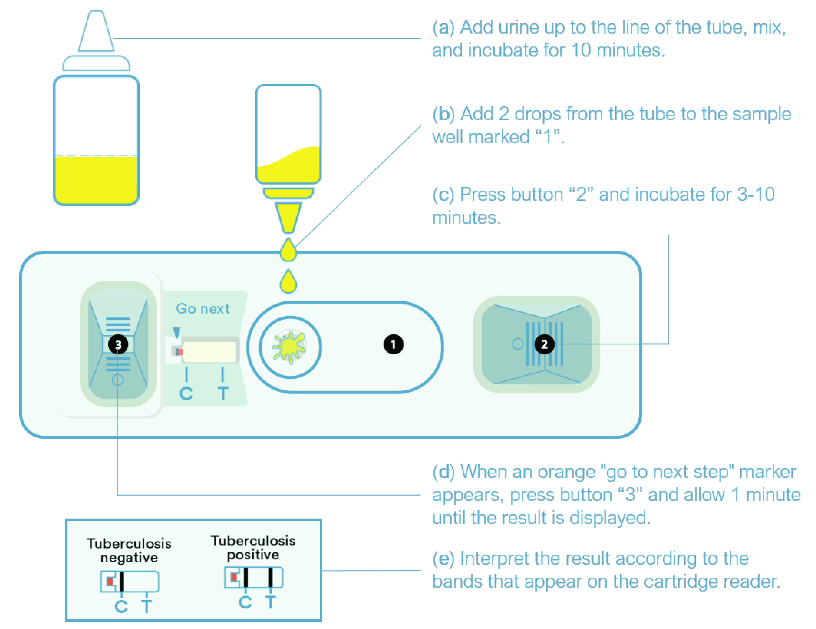

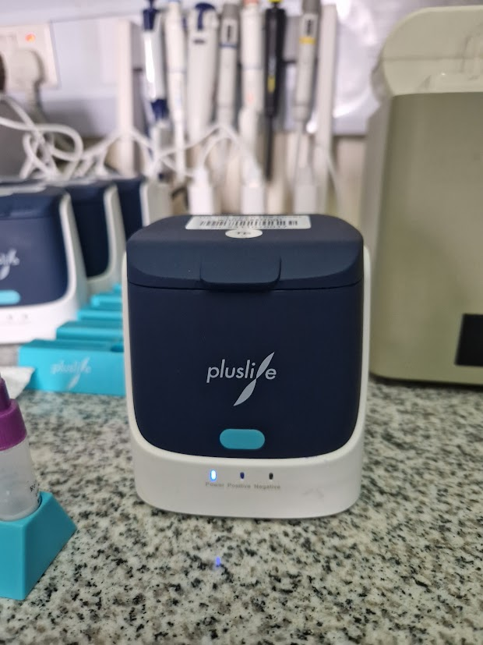
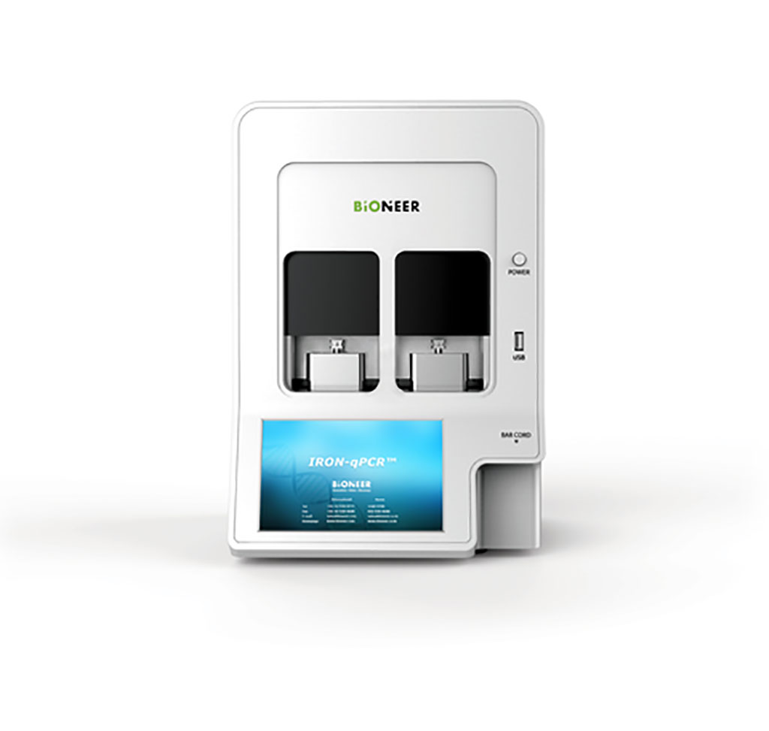
Global Fund’s Next Generation Market Shaping SI: Support improved access to quality TB diagnostics
Component
Activities
Eligible Products
1
Market size estimation to support and enable at-scale introduction of new TB Diagnostic tools
Support baseline assessment of WHO Diagnostic standards
Use existing DNO/DNAs to identify potential procurement needs for new low complexity NAATs, near POC platforms
Landscaping/mapping of CXRs & CAD in country
20 TB priority countries + 5 WCA
Urinary Point Of Care tests
3rd Generation LAM tests in trials
Larger market if indication broadens to outside PLHIV
WHO GDG 2026 may give guidance
2
Regional engagement to support demand for introduction of new diagnostic tools
Facilitate regional platforms for knowledge sharing to support potential demand generation and implementation planning
All interested countries in the region can participate
New sampling techniques with near Point-of-Care tests
Tongue swabs
Potentially very large market, depending on the indication
Use in new near point of care platforms
WHO GDG November 2025
3
Technical assistance to translate normative guidance into national strategies and planning
Provide technical support for guideline updates, trainings, etc. for new diagnostic tools.
Open to NPOC early adopter countries, likely towards end of GC7
Low complexity diagnostics
Multi-disease platforms
Similar space as GeneXpert and TrueNat
Additional competition to market with potential lower prices and better S&M
GDG Q2 2024 gave guidance on class with new products in mid-late 2025
Notes (1)Component 1, 2 and 3 to be implemented with support from TB partners.
(2)Continuous engagement & alignment among TB partners in this space will be ensured to avoid duplication.
(3)Tools used for component 1 can be made available for countries to adopt and use to map procurement needs and or CXR mapping.

Slide 12
About the NPOC Early Adopter Initiative
Primary goal:
Work with National Programs to accelerate routine implementation and scale-up of Near Point-of-Care Tests (pending WHO guidance) to ensure progress towards affordable access to molecular diagnostics as an initial TB diagnostic test.
Secondary goals:
Increase case detection by accelerating access to quality, affordable, near Point-of-Care TB diagnostics.
Integrate TB diagnostics into decentralized delivery models and introduce more affordable molecular diagnostics that could be transitioned into domestic financing.
Develop tools and experience to support introduction and accelerated scale-up of near Point-of-Care diagnostics in GC8 and ensure healthy market for sustainability.

Slide 13
Global Fund support for early adopters
1. Procurement Support
Use of the Access Fund as a co-pay mechanism.
Portion of cost will be borne by Global Fund directly with the remaining amount financed by the grant, in coordination with the PRs.
Procurement will need to be done via the Global Fund’s wambo/PPM platform.
More information on the co-pay mechanism and potential volume of products available will be shared ahead of the meeting in Nairobi.
Aim for procurement orders to be placed by the latest mid Dec 2025 for implementation S1 2026.
2. Technical Assistance
Technical Assistance support will be made available to National Programs during this initial implementation phase.
More information on the modalities will be shared in the next webinar.

Slide 14
What are the next steps?
Key dates in the timeline for the introduction of NPOC tests
WHO GDG on NPOC
+ Tongue swab
+ Pooling
NPOC roll-out in early adopter countries
Global Fund ERPD Approval of Plus Life MiniDock MTB test
Preparatory Webinars
WHO Rapid Communication
July
Aug
Sept
Oct
Nov
Dec
Jan
Feb
Mar
Apr
May
Invite countries to participate in Initiative
Early Adopters Workshop in Nairobi
NPOC Order placements
Public Announcement of Initiative
(24th Sept.)
Key Outcomes:
Finalize implementation plans
Articulate TA and funding needs

Slide 15
Thank you.

